Slide 1
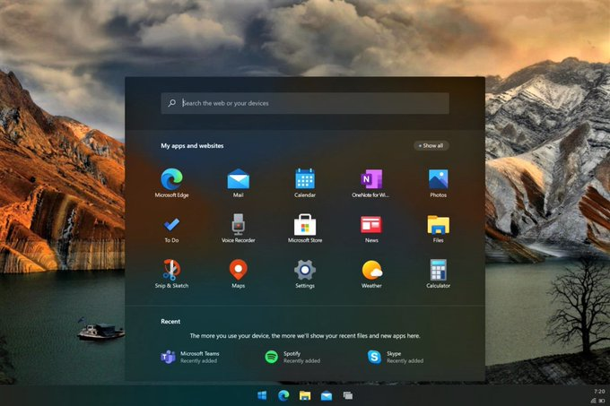
This Photo by Unknown Author is licensed under CC BY-SA-NC

Slide 2
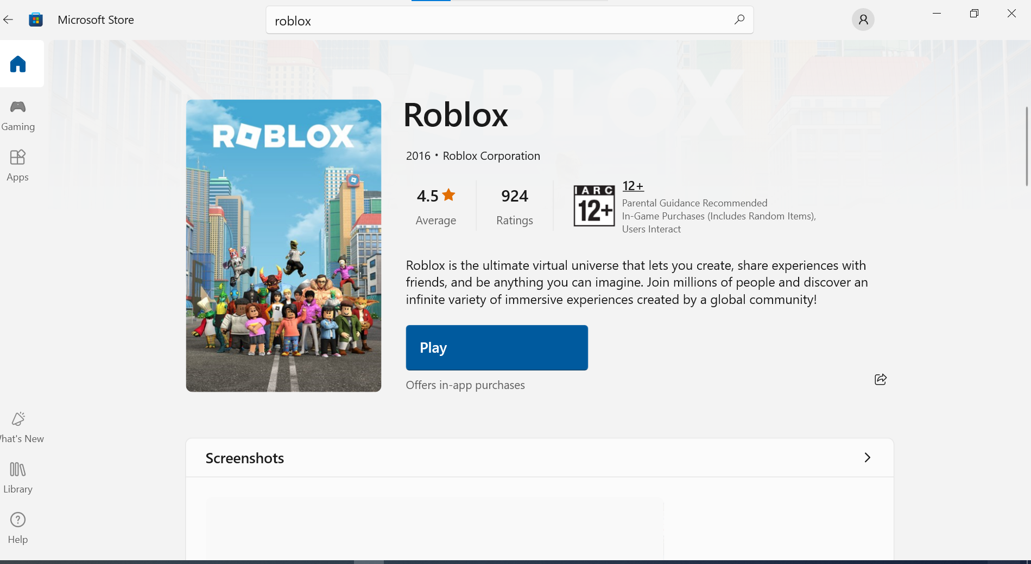

This Photo by Unknown Author is licensed under CC BY-SA-NC

Slide 3

This Photo by Unknown Author is licensed under CC BY-SA-NC

Slide 4
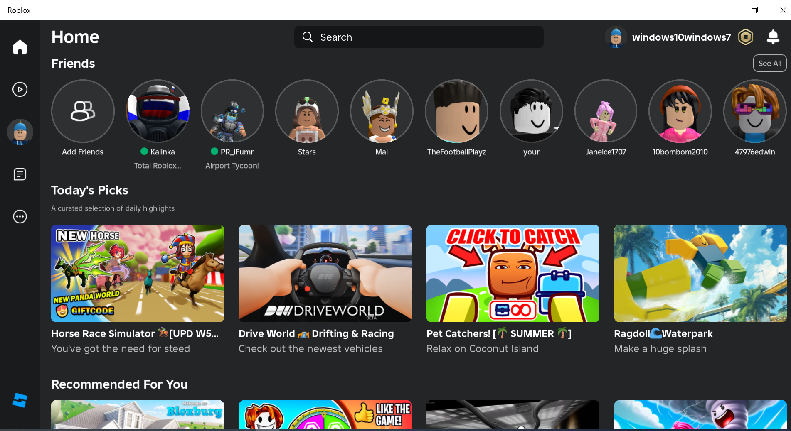

Slide 5
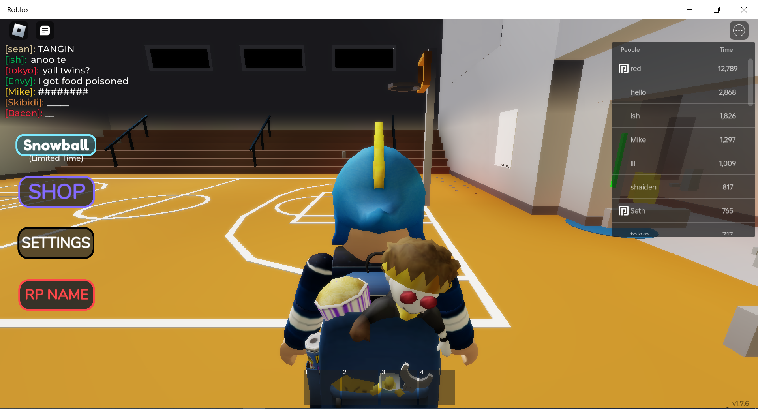

Slide 6
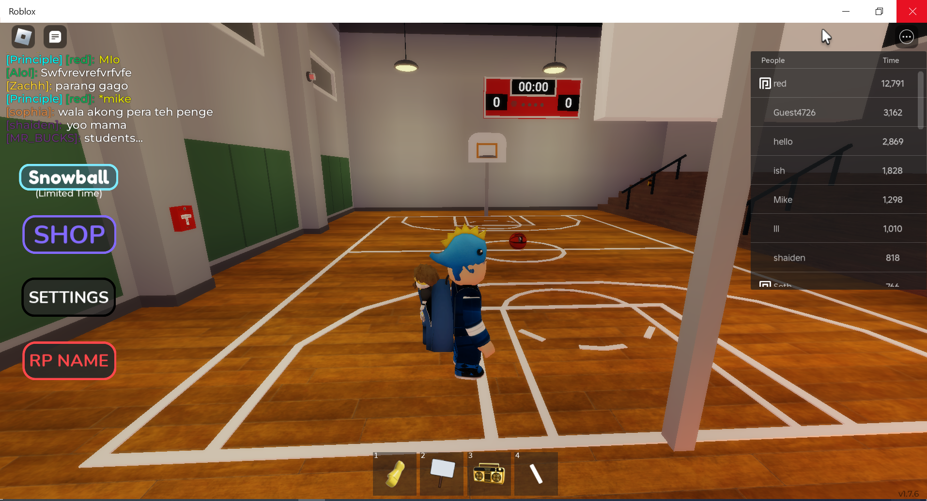
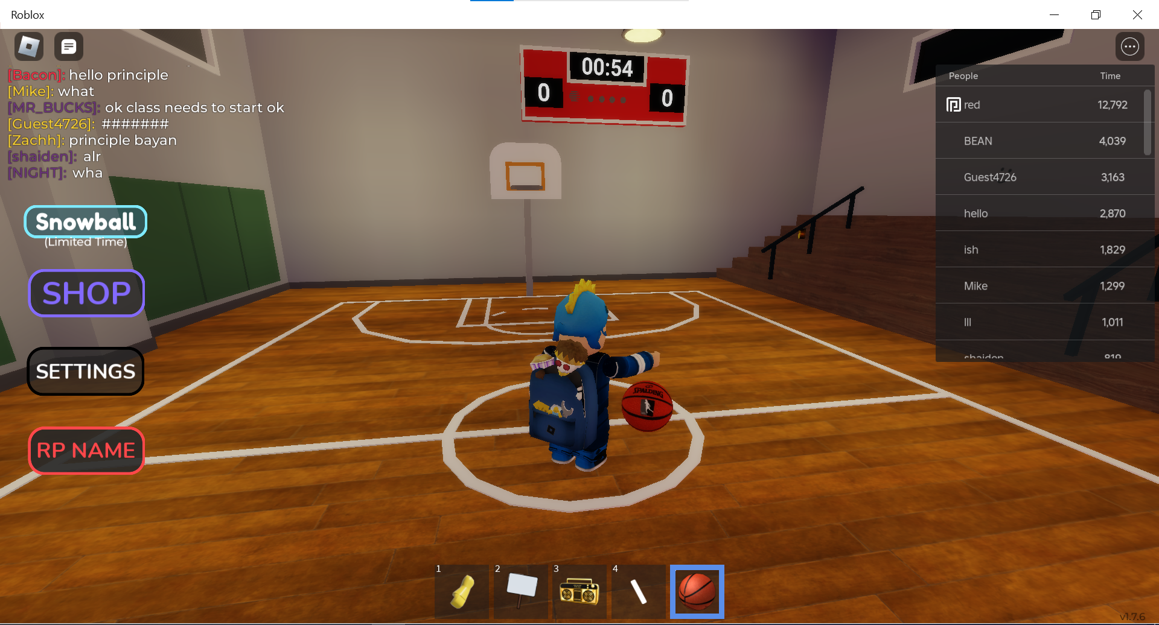

Slide 7
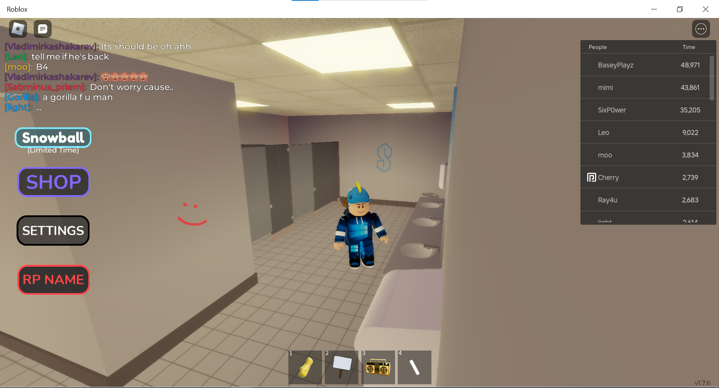

Slide 8
This Photo by Unknown Author is licensed under CC BY-SA-NC

Slide 9
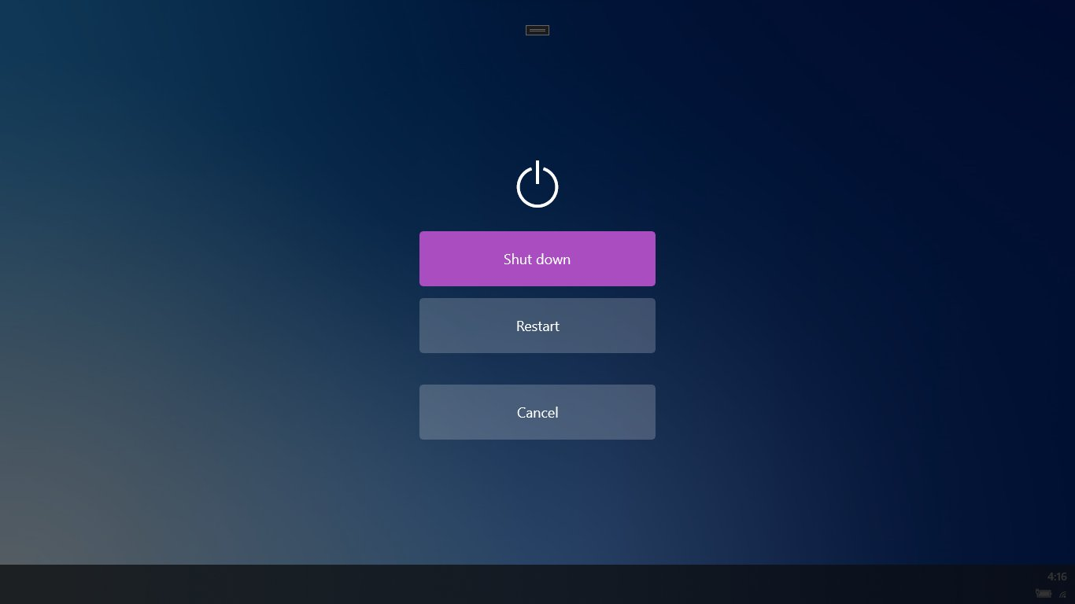
This Photo by Unknown Author is licensed under CC BY-SA-NC

Slide 10


